Slide 1
Serial and Parallel Port interfacing
UART Protocol

Slide 2
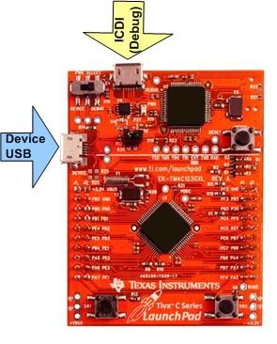
Tiva LaunchPad

Slide 3
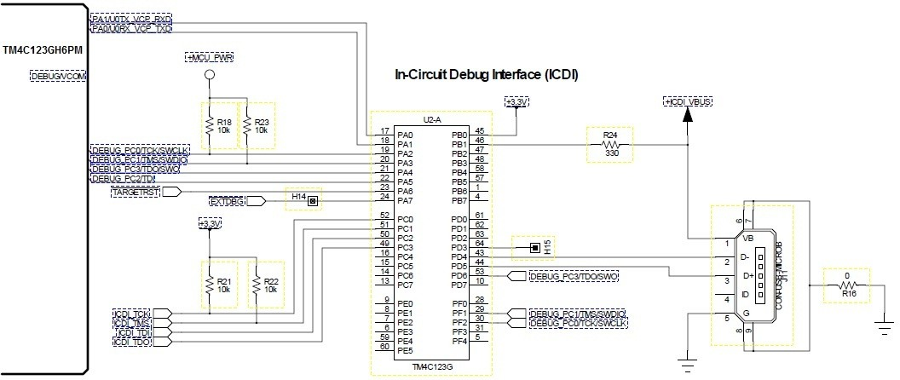
ICDI USB Port

Slide 4
Universal Asynchronous Receiver/Transmitter (UART)
UART (Serial Port) Interface
Send/receive a frame of (5-8) data bits with a single (start) bit prefix and a 1 or 2 (stop) bit suffix
Baud rate is total number of bits per unit time
Baudrate = 1 / bit-time
Bandwidth is data per unit time
Bandwidth = (data-bits / frame-bits) * baudrate

Slide 5
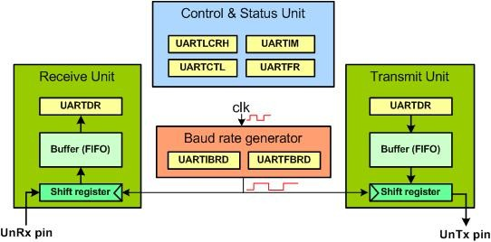
a Simplified Block Diagram of UARTn
16 element FIFO buffer
10bit shift register
UART is actually controlled by a clock which is 16 times faster than baud rate

Slide 6
UART - Transmitter

Slide 7
UART - Transmitter
Tx Operation
Data written to UART0_DR_R
passes through 16-element FIFO
permits small amount of data rate matching between processor and UART
Shift clock is generated from 16x clock
permits differences in Tx and Rx clocks to be reconciled

Slide 8
UART - Receiver

Slide 9
UART - Receiver
Rx Operation
RXFE is 0 when data are available
RXFF is 1 when FIFO is full
FIFO entries have four control bits
BE set when Tx signal held low for more than one frame (break)
OE set when FIFO is full and new frame has arrived
PE set if frame parity error
FE set if stop bit timing error means if baudrates of both devices do not match

Slide 10
UART – Overrun Error
17 frames transmitted and none read
=> overrun error

Slide 11
TM4C UART0 – Registers

Slide 12
UART Data (UARTDR)
Data to be written here when transmitting
Data to be read from here after receving

Slide 13
UARTn_RSR_R register
Separate error register
Bits can be cleared before communication starts

Slide 14

UART Flag Register (UARTFR)
Status of two FIFOs can be seen here
BUSY flag is set while the transmitter still has unsent bits , it will become zero when last bit is sent and FIFO is empty
TXFE: it is raised when FIFO is empty
RXFF: it is raised when FIFO is full
TXFF: low when FIFO is not full
RXFE: low when FIFO is empty

Slide 15

UART Control (UARTCTL)
UARTEN: enable/disable uart
HSE: high speed enable; for baud rate divisor which is by default 16, to change it to 8 set HSE to 1
RXE: receive enable
TXE: transmission enable

Slide 16
UART Line Control (UARTLCRH)
It is used for setting frame length
STP2: set this bit to 1 if 2 stop bits are required
FEN: enable FIFO (default size is 1 byte when FEN =0 else for 16 bytes FEN =1)
WLEN: (D6-D5) determine word length , 5 bits, 6bits, 7 bits or 8 bits.
D6 | D5
0 | 0 | 5 bits
0 | 1 | 6 bits
1 | 0 | 7 bits
1 | 1 | 8 bits

Slide 17
RCGCUART (UART Run Mode Clock Gating Control)

Slide 18
Baud Rate Generator
UARTIBRD and UARTFBRD are used for baud rate setting
16 bits + 6 bits are used = 22 bits
To reduce the error we use both registers
Desired baud rate = SysClk/(16 x ClkDiv)
Example: for 16MHz, baud rate of 4800 ClkDiv = 208.3333
UARTIBRD = 208
UARTFBRD = 0.333x 64 = 21. 312 = 21

Slide 19
I/O PORT setting for UART
Enable digital or analog function
Enable alternate function
Select alternate function

Slide 20

GPIO Alternate Function Select (GPIOAFSEL)
Make bit for respective pin = 1 for which alternate function has to be enabled

Slide 21

GPIOPCTL Register
4 bit value for alternate function (next slide)

Slide 22
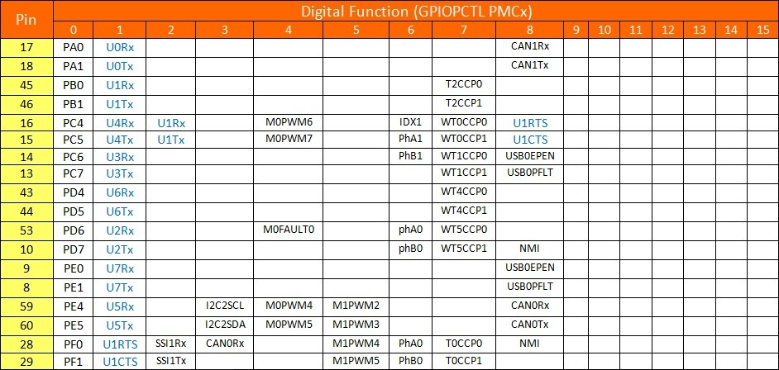
Alternate function value for each pin

Slide 23
TM4C UART Setup
UART0 operation
UART clock started in SYSCTL_RCGCUART_R
Digital port clock started in SYSCTL_RCGCGPIO_R
UART0_CTL_R contains UART enable (UARTEN), Tx (TXE), and Rx enable (RXE)
set each to 1 to enable
UART disabled during initialization
UART0_IBRD_R and UART_FBRD_R specify baud rate
bit rate = (bus clock frequency)/(16*divider)
For example we want 19.2 kb/s and bus clock is 8 MHz
8 MHz/(16*19.2 k) = 26.04167 = 11010.000011₂
Tx and Rx clock rates must be within 5% to avoid errors
GPIO_PORTB_AFSEL_R to choose alternate function
Write appropriate values to GPIO_PORTB_PCTL_R
GPIO_PORTB_DEN_R Enable digital I/O on pins 1-0
GPIO_PORTB_AMSEL_R no Analog I/O on pins 1-0
write to UART0_LCRH_R to activate
Notes:
FBRD is a fixed-point number with Delta=2⁻⁶. So in the example above we write .04167 as integer round(0.04167*2⁶) = round(2.669) = 3.

Slide 24
UART Module 1 Setup
// Assumes a 50 MHz bus clock, creates
//115200 baud rate
void UART_Init(void)
{
SYSCTL_RCGCUART_R |= 0x0002; // activate UART1
SYSCTL_RCGCGPIO_R |= 0x0002; // activate port B
UART1_CTL_R &= ~0x0001; // disable UART
UART1_IBRD_R = 27;
// IBRD=int(50000000/(16*115,200))
//=int(27.1267)
UART1_FBRD_R = 8;
// FBRD = round(0.1267 * 64) = 8
UART1_LCRH_R = 0x0070; // 8-bit length, enable FIFO
UART1_CTL_R = 0x0301; // enable RXE, TXE and UART
GPIO_PORTB_AFSEL_R |= 0x03; // alt funct on PB1-0
GPIO_PORTB_PCTL_R = 0x00000011;
GPIO_PORTB_DEN_R |= 0x03; // digital I/O on PB1-0
GPIO_PORTB_AMSEL_R &= ~0x03; // No analog on PB1-0
}
Notes:
The PCTL register gets the Column number from table in slide 5. In this example the lower two nibbles are 1 and 1 indicating that we are using PortB pins 0 and 1 for Receive and Transmit. You will find PB0 and PB1 in rows 7-8 column 1

Slide 25
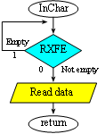
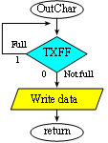
UART Busy-Wait Send/Recv
// Wait for new input,
// then return ASCII code
uint8_t UART_InChar(void) {
while((UART1_FR_R&0x0010) != 0);
// wait until RXFE is 1
return((uint8_t)(UART1_DR_R&0xFF));
}
// Wait for buffer to be not full,
// then output
void UART_OutChar(uint8_t data) {
while((UART1_FR_R&0x0020) != 0);
// wait until TXFF is 0
UART1_DR_R = data;
}
Notes:
Show how to convert to UART1

Slide 26
Problem statement: Send message to PC connected with Launchpad and receive data
Send a message “HELLO” at 9600 baud rate
Receive a character
Send next character
Repeat
Note: we will use UART module 0 as ICDI port is connected with PORTA

Slide 27
solution
void UART0Tx(char);
char UART0Rx(void);
int main(void)
{
SYSCTL_RCGCUART_R |= 1; /* provide clock to UART0 */
SYSCTL_RCGCGPIO_R |= 1; /* enable clock to PORTA */
/* UART0 initialization */
UART0_CTL_R = 0; /* disable UART0 */
UART0_IBRD_R = 104; /* 16MHz/16=1MHz, 1MHz/104=9600 baud rate */
UART0_FBRD_R = 11; /* fraction part, see Example 4-4 */
UART0_CC_R = 0; /* use system clock */
UART0_LCRH_R = 0x60; /* 8-bit, no parity, 1-stop bit, no FIFO */
UART0_CTL_R = 0x301; /* enable UART0, TXE, RXE */
/*TX0 and RX0 use PA0 and PA1. Set them up. */
GPIO_PORTA_DEN_R = 0x03; /* Make PA0 and PA1 as digital */
GPIO_PORTA_AFSEL_R = 0x03; /* Use PA0,PA1 alternate function */
GPIO_PORTA_PCTL_R = 0x11; /* configure PA0 and PA1 for UART */

Slide 28
Solution (contd.)
uint32_t i;
char x;
for (i=0;i<200000;i++); some de
UART0Tx(‘H’);
UART0Tx(‘E’);
UART0Tx(‘L’);
UART0Tx(‘L’);
UART0Tx(‘O’);
for(;;)
{
x= UART0Rx();
UART0Tx(x+1);
}
}

